Slide 1
Internal Assessment
Investigation
Assessment
Criteria

Slide 2
Total of 24 Marks – 20% of IB score
IB moderators will look at these five main criteria…
Personal engagement – 2 Marks (1 Aspect)
Independent and creative thinking, personal ownership and initiative are demonstrated in the investigation
Exploration – 6 Marks (3 Aspects)
Focused, researched, well-designed and outlined investigation is presented
Analysis – 6 Marks (3 Aspects)
Sufficient and relevant raw and correctly-processed data are gathered and displayed - including uncertainties
Evaluation – 6 Marks (3 Aspects)
A valid conclusion is described and justified, weaknesses and suggested improvements to investigation are discussed
Communication – 4 Marks (2 Aspects)
The overall presentation is clear, relevant, and concise

Slide 3
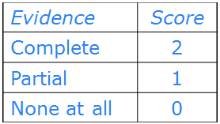
Personal Engagement [ 2 Marks ]
Aspect 1 [2]
Independent thinking
Creativity
Personal significance
Ownership

Slide 4
Exploration [ 6 Marks ]
Aspect 1 [2]
Focus the problem
Relevant background
List the variables
Dependent
Independent
Significant Controls
Aspect 2 [2]
Method
Keep each control constant
Materials
Picture or sketch
Clear and simple
Helps moderators
Aspect 3 [2]
Variations
Sufficient to expose trend
Appropriate range of values
Three averaged trials for each variation

Slide 5
A sample experiment The effect of surface on rebound height of a ball. Exploration [ 6 marks ]
•The title should reflect a very focused line of research.
The effect of surface on rebound height of a ball.
•A well-designed experiment should have one independent (manipulated) variable and one dependent (responding) variable, and should produce a function, rather than a bar graph.
NOTE: There may be more than one dependent variable, but only one of these should be measured/considered throughout the experiment.
•The aim is a clear statement whose purpose is to give the reader a good idea of what to expect upon further reading. This is the “relevant background.”
The aim of this investigation is to determine the effect of changing the surface on to which a ball is dropped on the rebound height of that ball.
•The dependent variable should be described.
ASPECT 1
ASPECT 1
Notes:
© 2006 By Timothy K. Lund

Slide 6
A sample experiment The effect of surface on rebound height of a ball. Exploration [ 6 marks ]
•The independent variable should be described.
The experiment is limited to increasing the number of sheets of paper on to which the ball is dropped.
•An adequate range of variations should be explained.
The number of sheets of paper is increased from 0 to 16 in steps of 2. The sheets are attached to the hard floor surface.
•Significant controls should also be described.
The ball is always dropped from the same height and from rest.
ASPECT 1
ASPECT 1
ASPECT 3
ASPECT 1
Notes:
© 2006 By Timothy K. Lund

Slide 7
A sample experiment The effect of surface on rebound height of a ball. Exploration [ 6 marks ]
•A list of materials or equipment should include everything that will be used. Be sure that everything in the list is used, and that nothing is missing from the list.
Apparatus/Materials
electronic balance
rubber ball
a meter stick
sticky tape
A4-size paper
butcher's paper
marking pen
ASPECT 2
Notes:
© 2006 By Timothy K. Lund

Slide 8
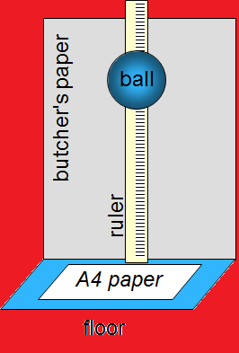
A sample experiment The effect of surface on rebound height of a ball. Exploration [ 6 marks ]
Method
•Include a sketch or picture to assist the reader in understanding your investigation. Cite your sources!
1 Set up the equipment as shown in the sketch.
2 Release the ball in a straight line from a height of 70.0 cm.
3 Mark the highest point of the top of the ball of the first bounce on the butcher's paper.
•At least 3 trials for each variation are needed.
4 Repeat this three times, numbering the lines on the butcher's paper.
5 Place 2 sheets of A4 paper on the floor where the ball will bounce.
6 Repeat steps 2 through 5 until data has been gathered for 16 sheets of paper.
ASPECT 2
ASPECT 2
ASPECT 3
ASPECT 3
Notes:
© 2006 By Timothy K. Lund

Slide 9
Analysis [ 6 Marks ]
Aspect 1 [2]
Data table
Name
Symbol
Units
Estimated raw uncertainty to 1 SF
Consistent SFs
Aspect 2 [2]
Sample calculations of average
Calculate uncertainty in average using range/2 to 1 SF

Slide 10
Analysis [ 6 Marks ]
NOTE: If no processing of raw data is required then Aspect 2 consists of graphing, best line fit, slope.
Aspect 3 [2]
Graph data as scatter plot
Label axes with name, symbol, and units
Best fit trend line - usually linear
Uncertainty bars - most uncertain variable
Graph min and max slopes to find uncertainty

Slide 11
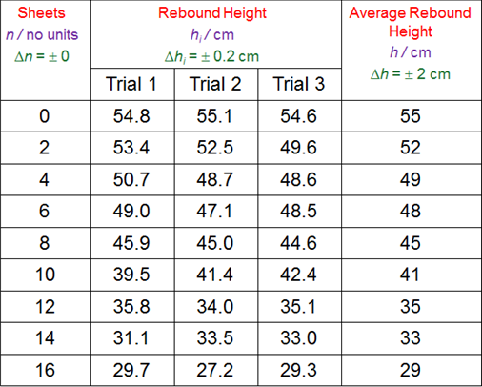
A sample experiment The effect of surface on rebound height of a ball. Analysis [ 6 marks ]
ASPECT 1
Experimental Data and Calculations
•Headings will have
NAME
Sheets
SYMBOL / UNITS
n / no units
UNCERTAINTY
Δn = ± 0
•Trials will all be recorded.
•Decimal places will be consistent within each heading/column subgroup.
•Data will be centered and unitless (the units are in the heading).
Notes:
© 2006 By Timothy K. Lund

Slide 12
A sample experiment The effect of surface on rebound height of a ball. Analysis [ 6 marks ]
The average rebound height h was calculated from each of the three trials. For the first row of data, h was calculated like this:
•Sample calculations are required for at least one trial set.
I have rejected and not recorded some measurements because the ball did not bounce along the vertical. When this happened I just repeated the drop. When the ball moves off at a noticeable angle some of the kinetic energy of the rebound is consumed in the horizontal component of motion, detracting from the rebound height.
•Explanations of special circumstances are encouraged.
ASPECT 2
h₁ + h₂ + h₃
54.8 + 55.1 + 54.6
3
h =
=
= 55
3
Notes:
© 2006 By Timothy K. Lund

Slide 13
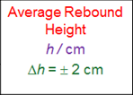
A sample experiment The effect of surface on rebound height of a ball. Analysis [ 6 marks ]
•The explanation accompanying the presentation of the data should justify all of the uncertainties:
Counting the sheets of paper has no uncertainty.
The rebound height is measured on the fly. I estimate the uncertainty to be about ±0.2 cm.
•Be sure to justify how you calculated the uncertainty in the dependent variable column:
The uncertainty in the height was taken to be half the largest range in the trial data, corresponding to the row for 2 sheets of paper:
ASPECT 1
ASPECT 2
53.4 - 49.6
2
= 2
Notes:
© 2006 By Timothy K. Lund

Slide 14
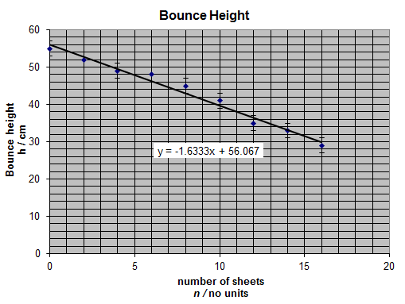
A sample experiment The effect of surface on rebound height of a ball. Analysis [ 6 marks ]
This graph shows the plot of average rebound height against the number of sheets of paper.
•The graph should be a scatter plot with disconnected dots and a best fit.
•The graph should have error bars on each point.
•The graph should have an equation.
•The graph should have labeled axes.
•The graph should have a title, and grid lines.
ASPECT 3
Notes:
© 2006 By Timothy K. Lund

Slide 15
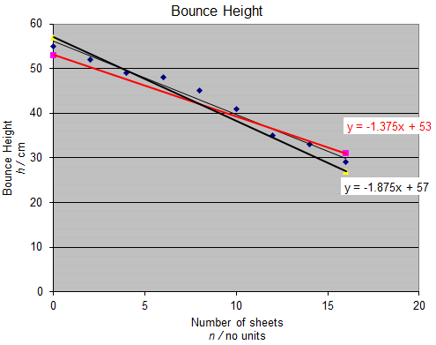
A sample experiment The effect of surface on rebound height of a ball. Analysis [ 6 marks ]
This graph shows the minimum and maximum slopes.
This is how I calculated the slope uncertainty:
From the previous graph, m = -1.6. Thus m = -1.6 ± 0.3.
•A clear English statement of the slope and its units with its interpretation must be present.
The slope of the graph is -1.6 ±0.3 cm sheet ⁻¹, which translates to “the ball loses 1.6 cm of rebound height for each sheet of paper added.”
ASPECT 3
m_{max} – m_{min}
Δm =
2
⁻1.375 – ⁻1.875
2
ASPECT 3
Δm =
Δm = ±0.3
Notes:
© 2006 By Timothy K. Lund

Slide 16
Evaluation [ 6 Marks ]
Aspect 1 [2]
A valid relationship (linear, proportional, inverse, none) is discussed and justified
Physical meaning of intercept(s)
Systematic error (if any)
Aspect 2 [2]
Discuss at least 2 weaknesses based on uncertainties and errors
Aspect 3 [2]
For each weakness discuss a realistic way to reduce

Slide 17
A sample experiment The effect of surface on rebound height of a ball. Evaluation [ 6 marks ]
Conclusion
The best line fit barely fits within the error bars - perhaps because the rebound height was so difficult to gauge. Perhaps data for 6 sheets and 8 sheets should have been retaken. These data points are just on the extremes of the error bars. I think we may conclude that for every sheet of paper added, the ball will lose 1.6 cm of rebound.
•A valid relationship (linear, proportional, inverse, none) is discussed and justified.
The y-intercept of my graph represents the height the ball would bounce if there were no paper between it and the floor, and is 56 cm. If the x-intercept were shown, it would represent the number of sheets of paper needed to prevent the ball from bouncing at all.
•The physical meaning of the intercepts are discussed.
ASPECT 1
ASPECT 1
Notes:
© 2006 By Timothy K. Lund

Slide 18
A sample experiment The effect of surface on rebound height of a ball. Evaluation [ 6 marks ]
ASPECT 2
Evaluation
Observing that the trend line only just fits within the error bars we might ask if our data really is a linear fit. The three main problems with the lab were
•accurately recording the rebound height
•ensuring that the ball falls and rebounds since a non-vertical rebound would lead to less height
•ensuring successive sheets of paper do not trap air as this would “pad” the floor more than the paper and lower the rebound height from what it should be.
•Be sure that your weaknesses/problems are explained in terms of how they would affect your data’s uncertainties/errors.
•Do NOT list any weaknesses/problems for which you cannot suggest a reasonable “fix.”
Notes:
© 2006 By Timothy K. Lund

Slide 19
A sample experiment The effect of surface on rebound height of a ball. Evaluation [ 6 marks ]
ASPECT 3
Suggested improvements
The first two points can be addressed by taking many more trials for each number of sheets of paper, or by recording each drop with a video camera.
The third point can be addressed by ironing the paper stack before each drop.
•Be certain your suggestions are realistic.
•Make sure your suggestions “fix” ALL of the listed weaknesses/problems in Aspect 2.
Notes:
© 2006 By Timothy K. Lund

Slide 20
Communication [4 Marks]
Aspect 1 [2]
Presentation is clear and well-structured throughout
The necessary information on focus, process, and outcomes are present
Aspect 2 [2]
The report is relevant and concise, facilitating a ready understanding of the focus, process, and outcomes

